Slide 1

Chapter 3:
Pattern Discovery in Data Mining
Notes:
‹#›

Slide 2
Objective
Definition and importance of pattern discovery in data mining
Applications and real-world examples of pattern discovery
Challenges and considerations in pattern discovery
‹#›

Slide 3
Introduction to Pattern Discovery
What Is Pattern?
Patterns: A set of items, subsequences, or substructures that occur frequently together (or strongly correlated) in a data set
Patterns represent intrinsic and important properties of datasets
What Is Pattern Discovery?
Pattern discovery: Uncovering patterns from massive data sets
Motivation examples: What products were often purchased together? What are the subsequent purchases after buying an iPad? What code segments likely contain copy-and-paste bugs? What word sequences likely form phrases in this corpus?
‹#›

Slide 4
Introduction to Pattern Discovery
Why Is Pattern Discovery Important?
Finding inherent regularities in a data set
Foundation for many essential data mining tasks
  Association, correlation, and causality analysis
  Mining sequential, structural (e.g., sub-graph) patterns
  Pattern analysis in spatiotemporal, multimedia, time-series, and stream data
  Classification: Discriminative pattern-based analysis
  Cluster analysis: Pattern-based subspace clustering
Broad applications
  Market basket analysis, cross-marketing, catalog design, sale campaign analysis, Web log analysis, biological sequence analysis
‹#›

Slide 5
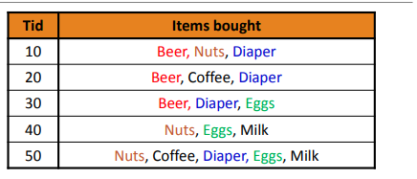
Introduction to Pattern Discovery
Basic Concepts: Frequent Itemsets (Patterns)
Itemset: A set of one or more items
k-itemset: X = {x1, …, xk}
(absolute) support (count) of X: Frequency or the number of occurrences of an itemset X
(relative) support, s: The fraction of transactions that contains X (i.e., the probability that a transaction contains X)
An itemset X is frequent if the support of X is no less than a minsup threshold (denoted as σ)
Let minsup = 50%
Freq. 1-itemsets:
  Beer: 3 (60%); Nuts: 3 (60%)
  Diaper: 4 (80%); Eggs: 3 (60%)
Freq. 2-itemsets:
  {Beer, Diaper}: 3 (60%)
‹#›

Slide 6
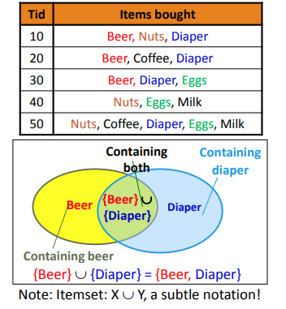
Introduction to Pattern Discovery
From Frequent Itemsets to Association Rules
Association rules: X→Y (s, c)
  Support, s: The probability that a transaction contains X ∪ Y
  Confidence, c: The conditional probability that a transaction containing X also contains Y
  c = sup(X ∪ Y) / sup(X)
Association rule mining: Find all of the rules, X→Y, with minimum support and confidence
‹#›

Slide 7
Introduction to Pattern Discovery
From Frequent Itemsets to Association Rules
Frequent itemsets: Let minsup = 50%
  Freq. 1-itemsets: Beer: 3, Nuts: 3, Diaper: 4, Eggs: 3
  Freq. 2-itemsets: {Beer, Diaper}: 3
Association rules: Let minconf = 50%
  Beer Diaper (60%, 100%)
  Diaper Beer (60%, 75%)
‹#›

Slide 8
Introduction to Pattern Discovery
Compressed Representation: Closed Patterns and Max-Patterns
Challenge: There Are Too Many Frequent Patterns!
  A long pattern contains a combinatorial number of sub-patterns
  How many frequent itemsets does the following TDB1 contain?
    TDB1: T1: {a1, …, a50}; T2: {a1, …, a100}
    Assuming (absolute) minsup = 1
    Let’s have a try
      1-itemsets: {a1}: 2, {a2}: 2, …, {a50}: 2, {a51}: 1, …, {a100}: 1, …, …, …, …
      100-itemset: {a1, a2, …, a100}: 1
    In total: (100 1) + (100 2) + … + (1 1 0 0 0 0) = 2100 – 1 sub-patterns!
‹#›

Slide 9
Introduction to Pattern Discovery
Compressed Representation: Closed Patterns and Max-Patterns
How to handle such a challenge?
  Solution 1: Closed patterns: A pattern (itemset) X is closed if X is frequent, and there exists no super-pattern Y כ X, with the same support as X
    Let Transaction DB TDB1: T1: {a1, …, a50}; T2: {a1, …, a100}
    Suppose minsup = 1. How many closed patterns does TDB1 contain?
      Two: P1: “{a1, …, a50}: 2”; P2: “{a1, …, a100}: 1”
  Closed pattern is a lossless compression of frequent patterns
    Reduces the # of patterns but does not lose the support information!
    You will still be able to say: “{a2, …, a40}: 2”, “{a5, a51}: 1”
‹#›

Slide 10
Introduction to Pattern Discovery
Compressed Representation: Closed Patterns and Max-Patterns
How to handle such a challenge?
  Solution 2: Max-patterns: A pattern X is a max-pattern if X is frequent and there exists no frequent super-pattern Y כ X
  Difference from close-patterns?
    Do not care the real support of the sub-patterns of a max-pattern
    Let Transaction DB TDB1: T1: {a1, …, a50}; T2: {a1, …, a100}
    Suppose minsup = 1. How many max-patterns does TDB1 contain? One: P: “{a1, …, a100}: 1”
  Max-pattern is a lossy compression!
  Thus in many applications, mining close-patterns is more desirable than mining max-patterns
‹#›

Slide 11
Introduction to Pattern Discovery
The Downward Closure Property of Frequent Patterns
Observation: From TDB1: T1: {a1, …, a50}; T2: {a1, …, a100}
  We get a frequent itemset: {a1, …, a50}
  Also, its subsets: {a1}, {a2}, …, {a50}, {a1, a2}, …, {a1, …, a49}, …
  There must be some hidden relationships among frequent patterns!
The downward closure (also called “Apriori”) property of frequent patterns
  If {beer, diaper, nuts} is frequent, so is {beer, diaper}
  Every transaction containing {beer, diaper, nuts} also contains {beer, diaper}
  Apriori: Any subset of a frequent itemset must be frequent
Efficient mining methodology ?
‹#›

Slide 12
Summary
Introduction to Pattern Discovery
Pattern discovery: Identifying valuable patterns in data.
Importance: Informing decisions, diverse applications.
Challenges: Data quality, scalability, interpretability.
‹#›

